Slide 1

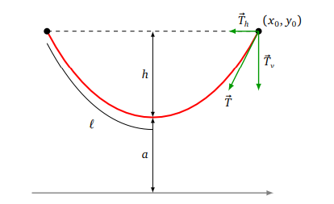




O

Slide 2







(0, 0)
xH
xrov
$$Pour x_{H}≤ x ≤ x_{rov} :y=a \left(ch\left(\frac{x − x_{H}}{a}\right) −1\right)$$
$y_{rov}=a$ $\left(ch\left(\frac{x_{rov} − x_{H}}{a}\right) −1\right)$
L = $x_{H}+a sh\left(\frac{x_{rov} −x_{H}}{a}\right)$
$$ach\left(\frac{y_{rov}+a}{a}\right)=\left(\frac{x_{rov} − x_{H}}{a}\right)$$
yrov
$$x_{rov}−a ach\left(\frac{y_{rov}+a}{a}\right)= x_{H}$$
$y_{rov}=a$ $\left(ch\left(\frac{x_{rov} }{a}\right) −1\right)$
$L_{0}$ = $a sh\left(\frac{x_{rov} }{a}\right)$

Slide 3




xH
(0, 0)
xrov
$$Pour x_{H}≤ x ≤ x_{rov} :y=y_{H}+ a ch\left(\frac{x − x_{H}}{a}\right)$$
$$0=y_{H}+ a ch\left(\frac{− x_{H}}{a}\right)$$
$$y_{rov}=y_{H}+ a ch\left(\frac{x_{rov} − x_{H}}{a}\right)$$
yrov
L = $a\left(sh\left(\frac{x_{rov} −x_{H}}{a}\right) −sh\left(\frac{−x_{H}}{a}\right)\right)$

